Slide 1

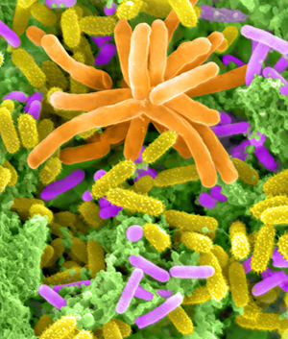
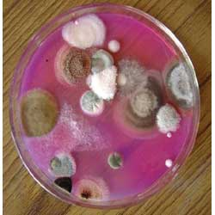
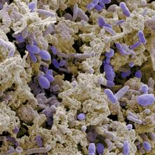
Solutions for microbial community analysis
AndersenLab
http://esd.lbl.gov/research/facilities/andersenlab/

Slide 2


Microbial* Life on Earth
Cells
Open Ocean 1.2 x 10²⁹
Soil 2.6 x 10²⁹
Oceanic Subsurface 3.5 x 10³⁰
Terrestrial Subsurface 0.25-2.5 x 10³⁰
All sources 4-6 x 10³⁰
60% of all biomass on earth
350-550 Pg of Carbon (60-100% more C then all plants)
85-130 Pg of N and 9-14 Pg of P (10 times more than all plants)
10⁵-10⁷ species
Capable of 4 simultaneous mutations in every gene in 0.4 h
Capable of dividing every 20 minutes
Human Body 10¹⁴ cells with 10¹⁵ bacteria, 5K-10K species
> 3.7 billion years of microbial evolution on earth
* Prokaryotes only, Pg = 10¹⁵ g
(in part Whitman et al., 1998)
Notes:
2

Slide 3
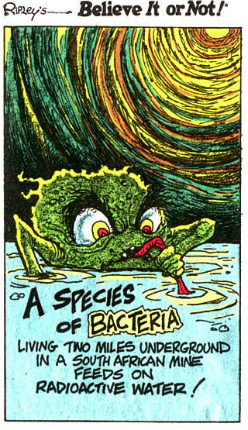
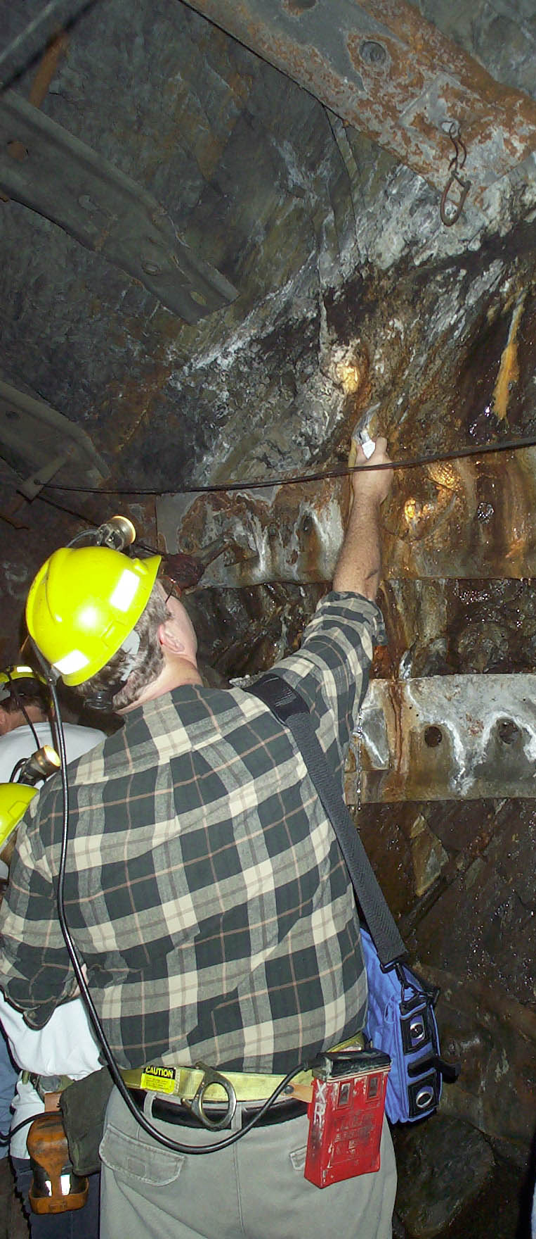
Lin et al. “Long-Term Sustainability of a High-Energy, Low-Diversity Crustal Biome” Science 10/06
Chivian et al. Science
Radioactivity splits water and regenerates system
Life on/under MARS?
Despite knowing most of the chemical conditions,
We could not grow
Desulforudis audaxviator
But it is the major organism there:
94+% (16S PCR) to 99.9+% (metagenomics) of the bacteria
So how do we study it?
Homestake Mine
8,000 ft Lead, SD
Notes:
3

Slide 4
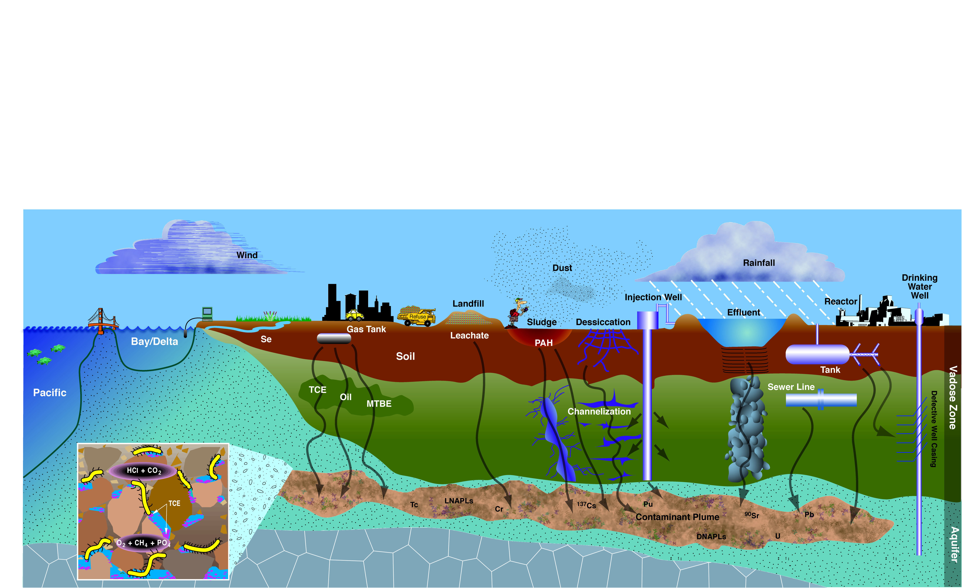
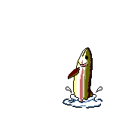
Environmental Biotechnology
Notes:
Pollution everywhere

Slide 5
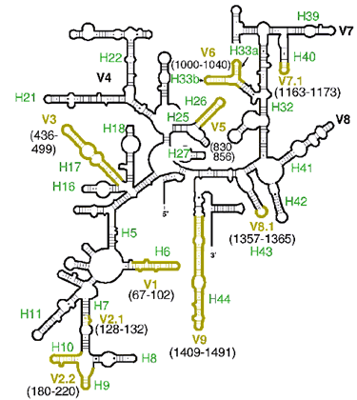
Stable biomarkers for molecular characteri-zation of microbial communities
  Small subunit rRNA (16S rRNA)
    Found in prokaryotic ribosomes
      Structurally conserved
    Conserved regions – useful for designing primers for PCR
    Variable regions useful for inferring phylogeny and distinguishing taxa

Slide 6
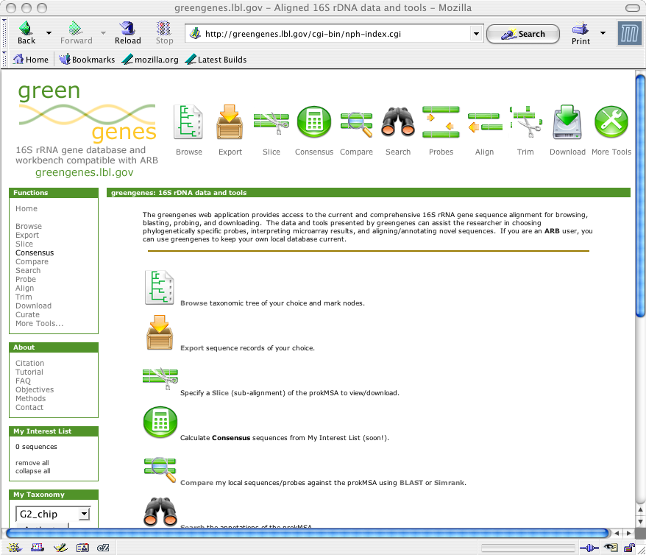
Database and Online Tools for
Microbial Ecology
http://greengenes.lbl.gov
Comprehensive 16S rRNA gene database
Quality controlled for chimera-checked full length genes
Worldwide resource, over 30,000 independent queries every month
Updated every 1-2 weeks
Compatible with Phylochip output.
T.Z. DeSantis et al. (2006) Greengenes: Chimera-checked 16S rRNA gene database
and workbench compatible with ARB. Appl. Environ. Micro. 72:5069-5072

Slide 7


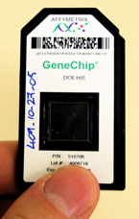
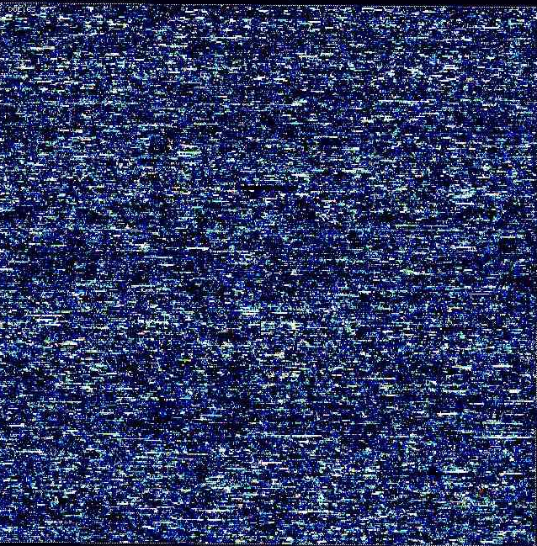
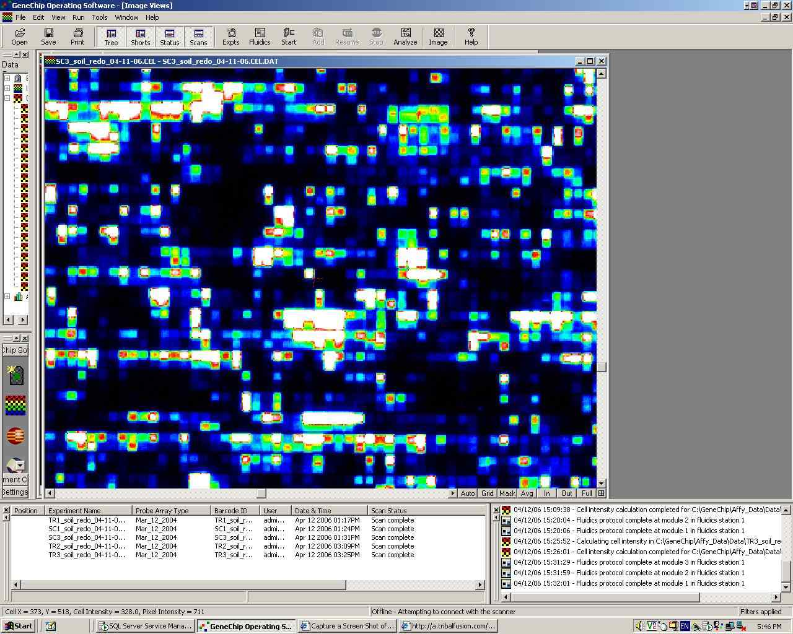
The Berkeley PhyloChip
comprehensive microbial census
1.1 million DNA probes to detect 59,995 bacteria
and archaea in a single test
Hierarchical probes for identification at multiple taxonomic levels
Rapid, repeatable and standardized method with statistical confidence
Quantitative ability validated by Latin Square analysis

Slide 8

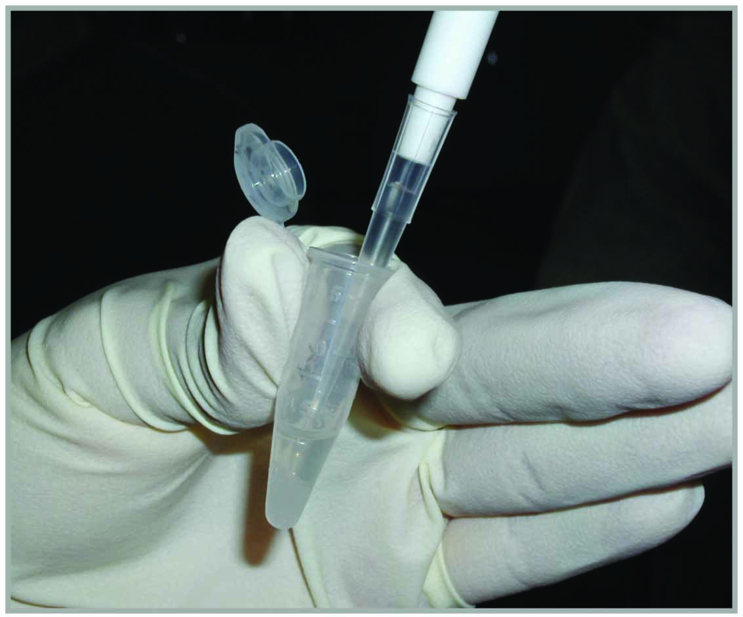
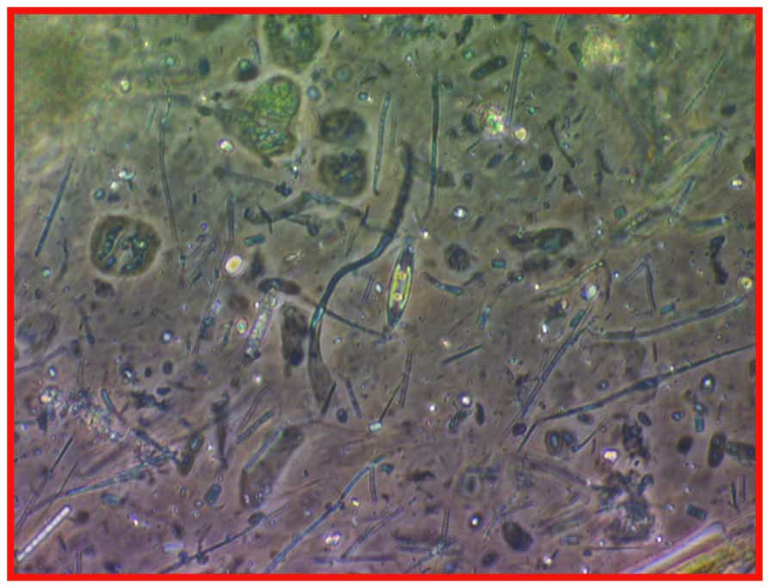
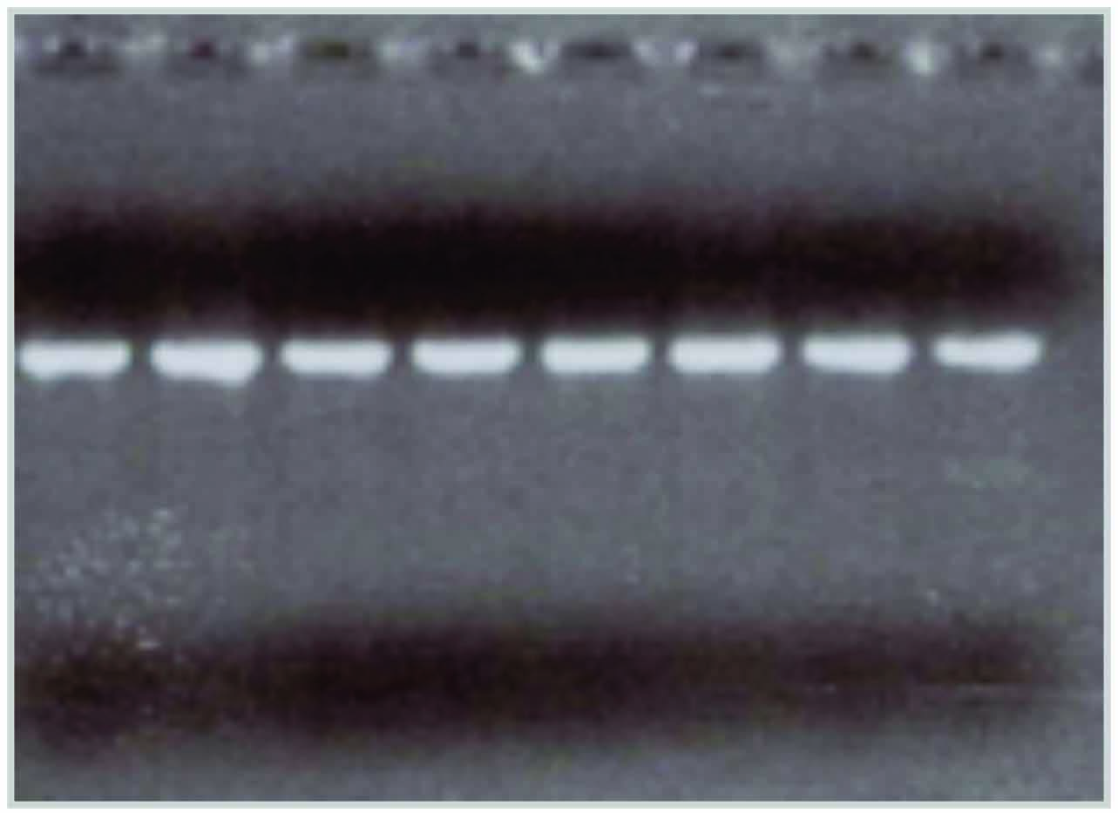
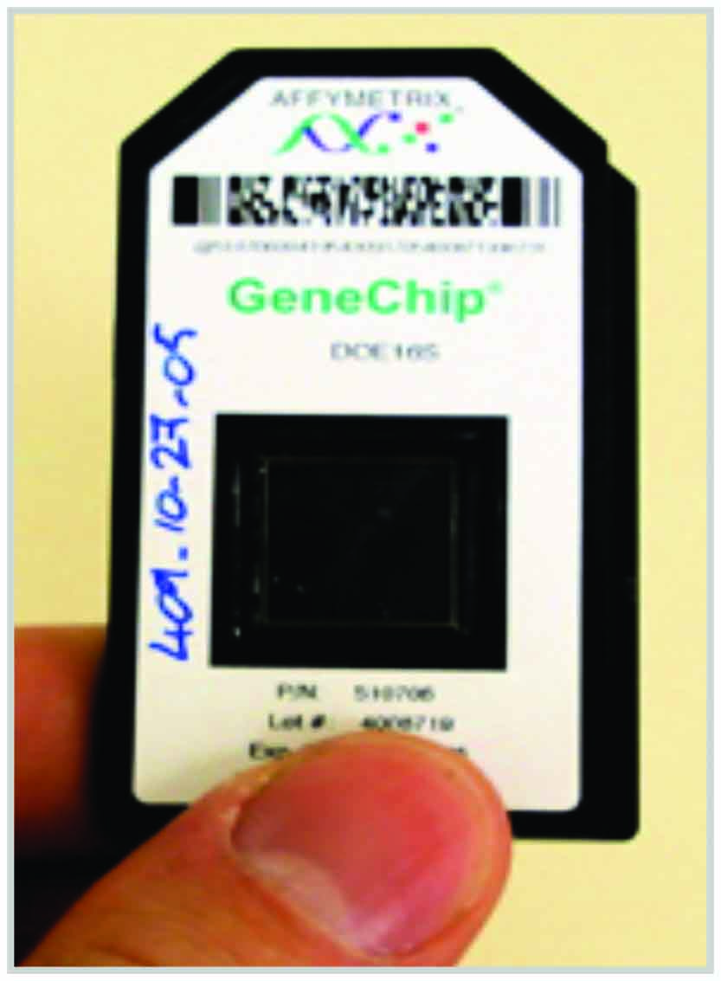
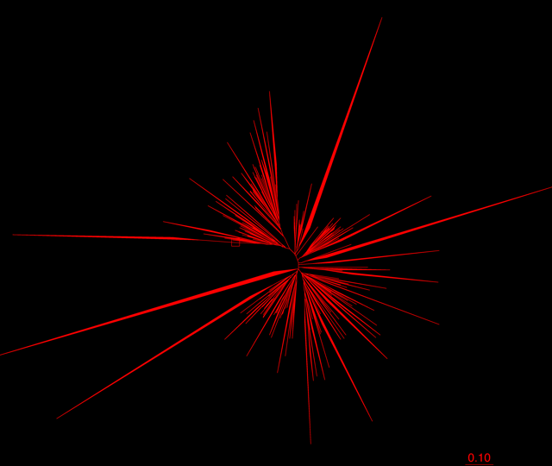
Sample preparation
Extract DNA from
fecal specimens
Amplify 16S rRNA gene with PCR
Profile of entire community
Analyze composition amplified DNA

Slide 9
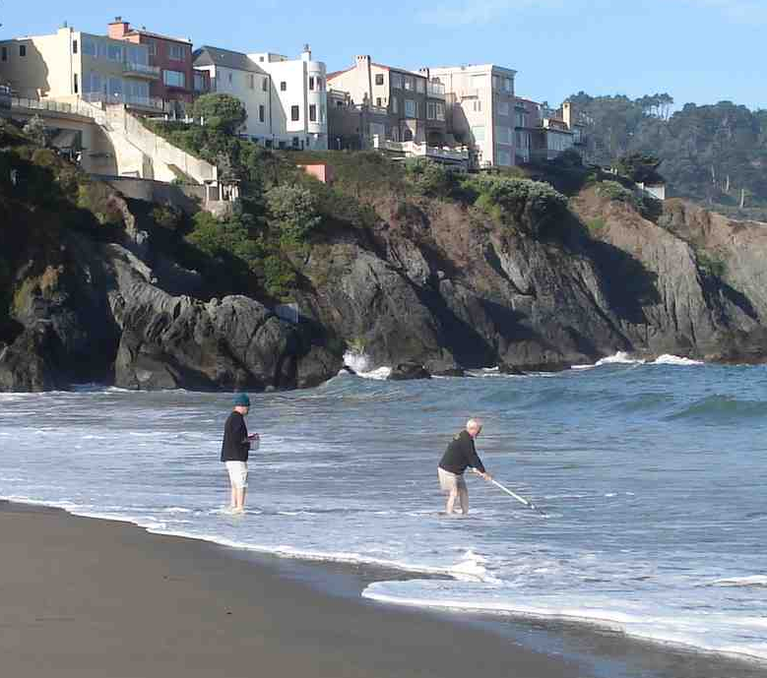
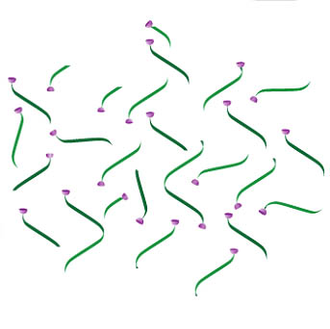
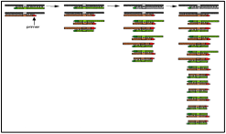
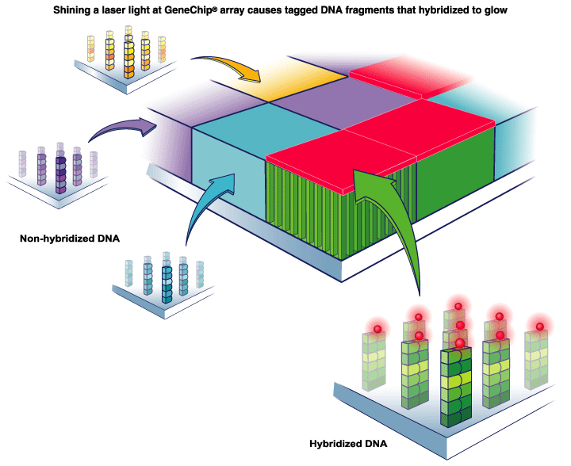
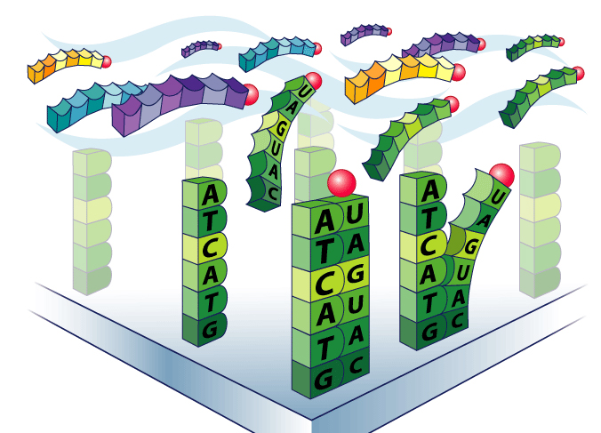
PhyloChip analysis
Extract DNA/RNA
Environmental sample
PCR amplification of
community 16S rRNA genes
Fragment and biotin label
Wash, stain and scan
Hybridize to array

Slide 10
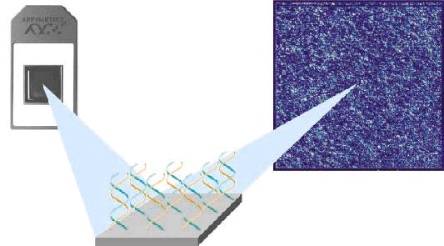
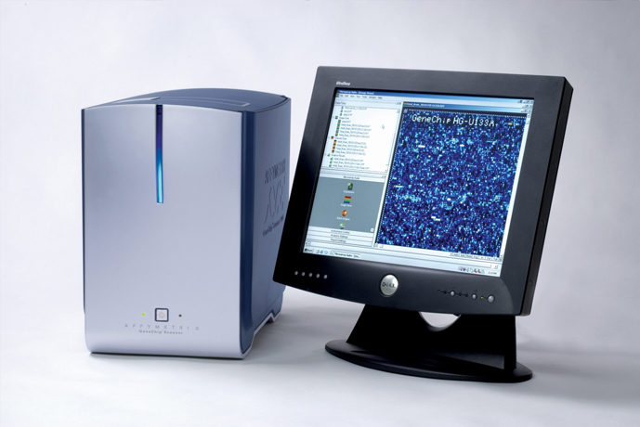
Fluorescent probes on PhyloChip are read by laser scanner on
confocal microscope to determine bacterial species composition
Specific probes target
which bacteria are present
Microarray scanner – integrated
laser and confocal microscope
“reads” the PhyloChip

Slide 11
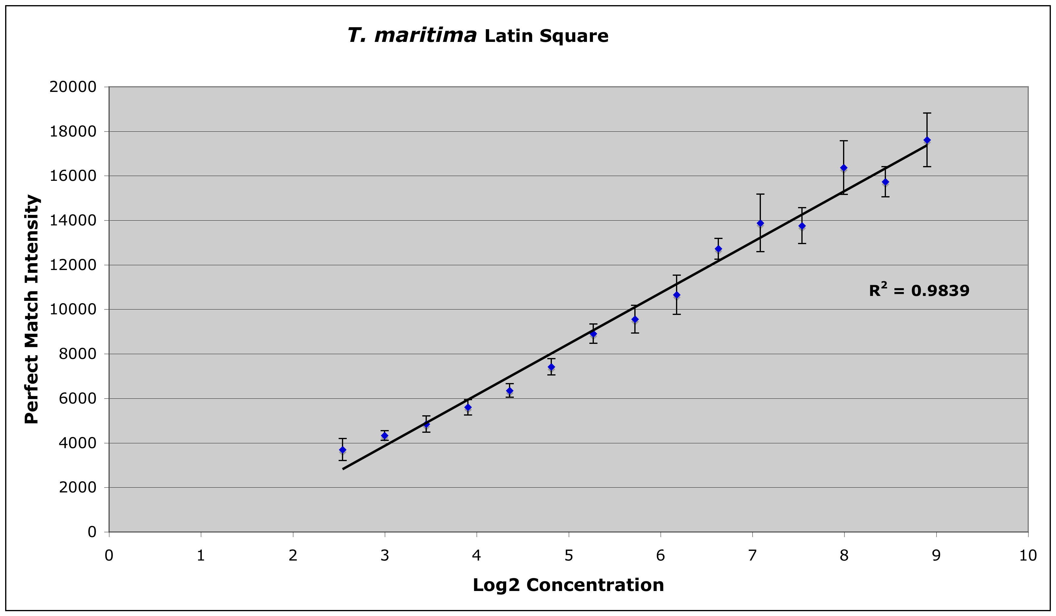
Probe-sets responsive to increasing concentration
Notes:
CV values ranged from 7 to 23%

Slide 12
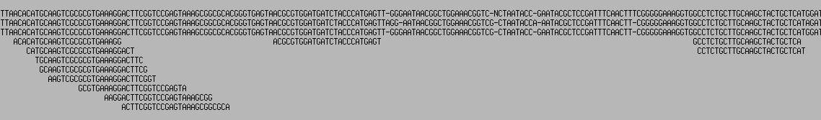


PhyloChip Probe Design
Desulfovibrio sp. str. DMB.
Desulfovibrio sp. 'Bendigo A'
Desulfovibrio vulgaris DSM 644
Example of the Location of Probes Used for
the Desulfovibrio vulgaris Probe Set
Sequence discrepancies
Regions not unique to OTU
Bacteria; Proteobacteria; Deltaproteobacteria; Desulfovibrionales; Desulfovibrionaceae; sf_1; otu_10051
27
1492
Regions unique to OTU

Slide 13
Advantages of phylogenetic microarray approach to microbial community monitoring in the environment
Analysis of entire pool of community 16S rRNA allows detection of very low abundance taxa
Reproducible for multiple replicates and comparable with other experiments
Controls built into each microarray to check performance characteristics of each sample
No artificial inflation of low abundance taxa (rare biosphere) due to sequencing errors
Responsive probes can be down-selected for follow up diagnostic tests

