Slide 1
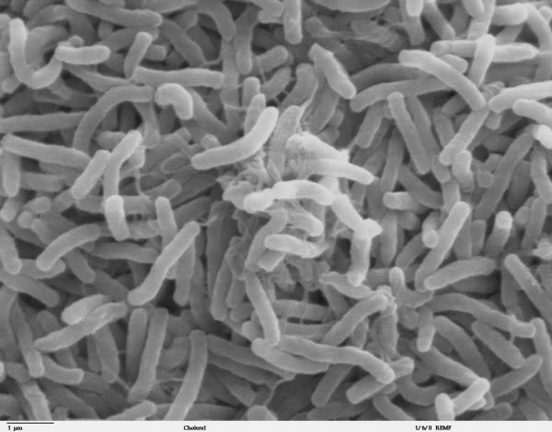
Harnessing the power of fecal microbial communities to assess health risks in the environment
Eric Dubinsky
Lawrence Berkeley National Laboratory

Slide 2
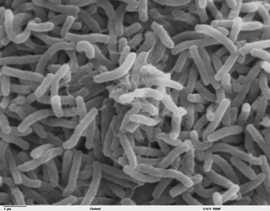
Microbes love your guts
100 trillion microbial cells in human gut
Diverse: 300 – 1000 species in each gut
At least 80% of species uncultivated, known only by DNA sequencing
Conventional tests do not measure most fecal bacteria

Slide 3
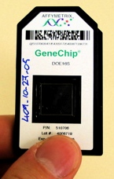
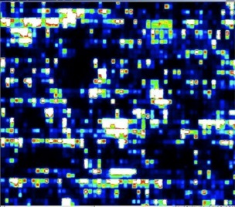
Community DNA sequence analysis: taking stock of everybody
Comprehensive census of microbial community is cheaper, faster than ever
Opportunity to use communities instead of single markers to identify pathogen sources and health risks
Can develop tests that are far more specific and accurate than current assays for monitoring fecal pollution

Slide 4
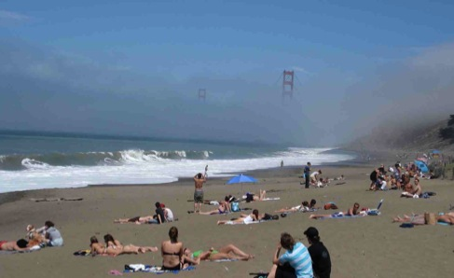
Clean Beaches Project
Use PhyloChip to improve fecal source tracking in recreational waters
Develop new fecal indicator tests based on microbial community differences among suspected fecal sources
Identify bacteria associated with bad water quality at popular California beaches to determine source of contamination

Slide 5
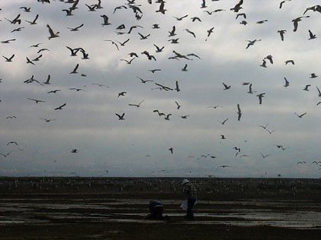
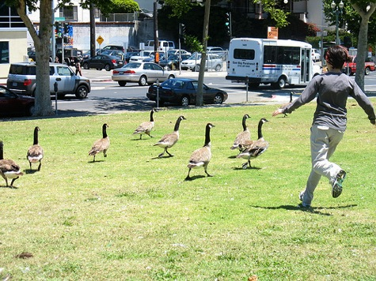
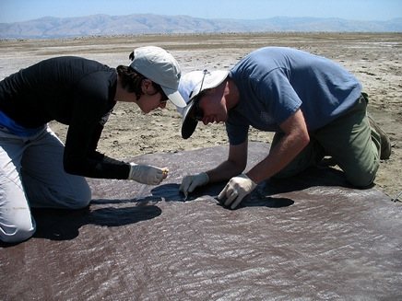
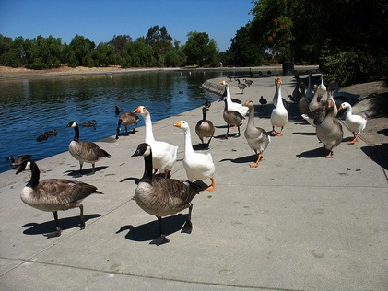
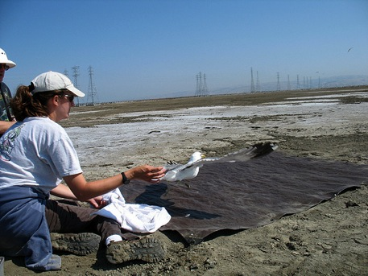
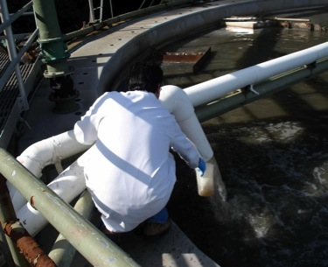
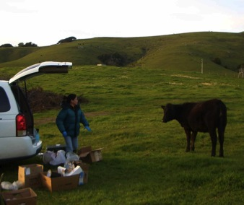
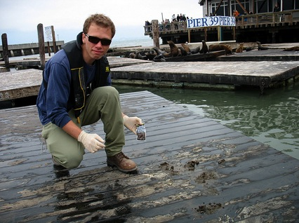
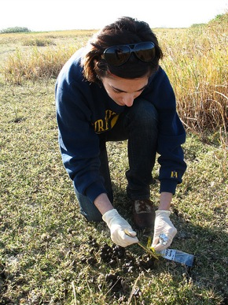
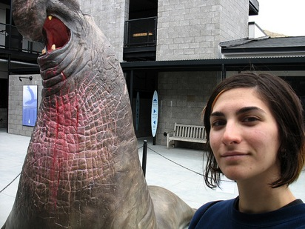
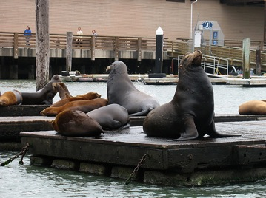
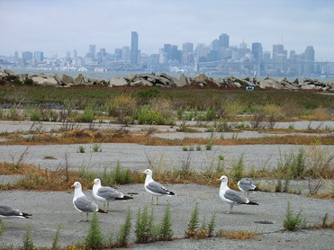

Slide 6
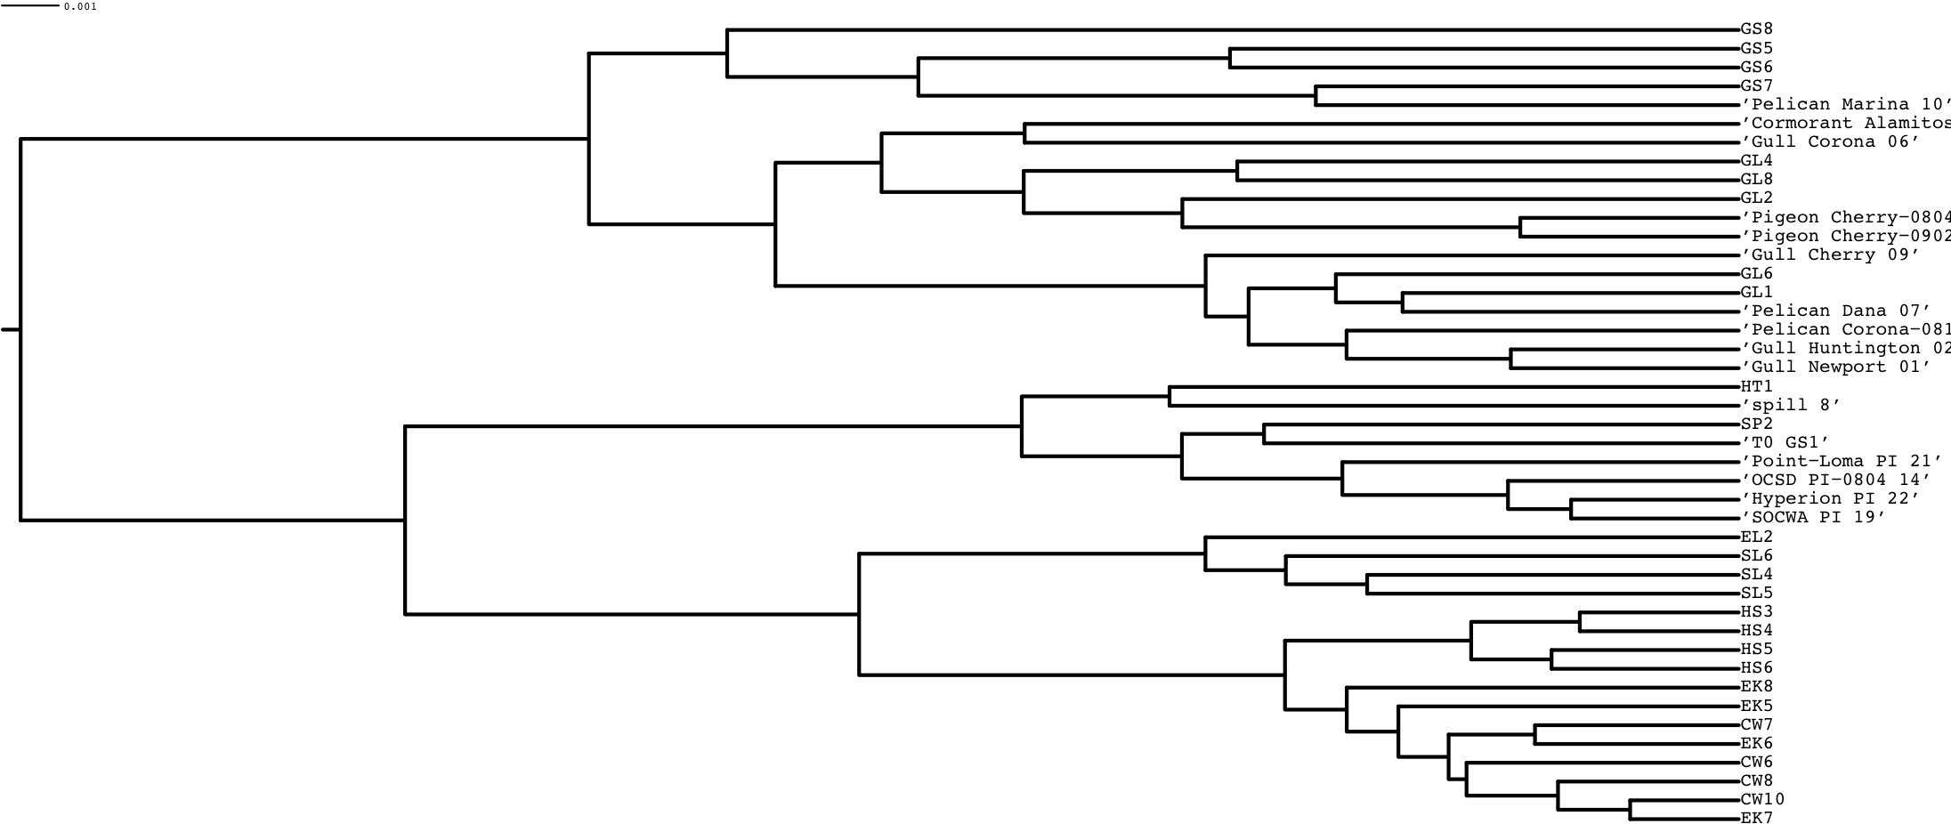
Fecal samples can be classified based on microbial community composition
mammals
birds
humans
grazers
pinnipeds
elk
elk
elk
gull
gull
gull
gull
gull
gull
gull
gull
cow
gull
cow
cow
cow
elk
horse
seal
horse
horse
horse
goose
goose
goose
sewage
goose
sewage
pigeon
pelican
pigeon
sea lion
pelican
pelican
sea lion
sea lion
sewage
sewage
sewage
sewage
septage
septage
cormorant
Detected 1548 different bacterial subfamilies in fecal samples
Human sources form distinct cluster despite type of waste processing
Little variation among populations of ruminant animals
Variation among populations of each bird species greater than mammals
Notes:
Strong potential for source identification based on bacterial community differences

Slide 7
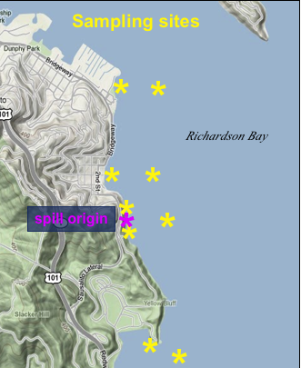
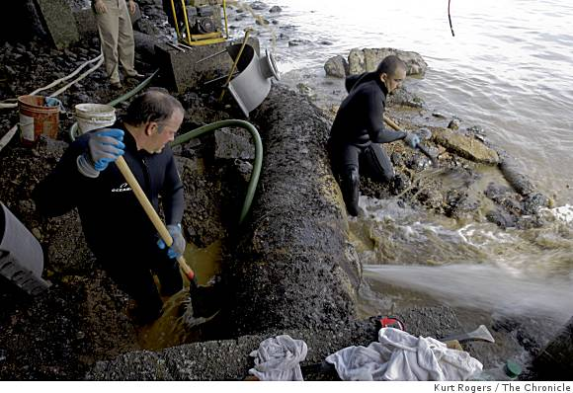
Field application: sewage spill monitoring
764,000 gallon sewage spill from Sausalito treatment plant into San Francisco Bay (2009)
Were high bacteria counts in Bay due to sewage spill?

Slide 8
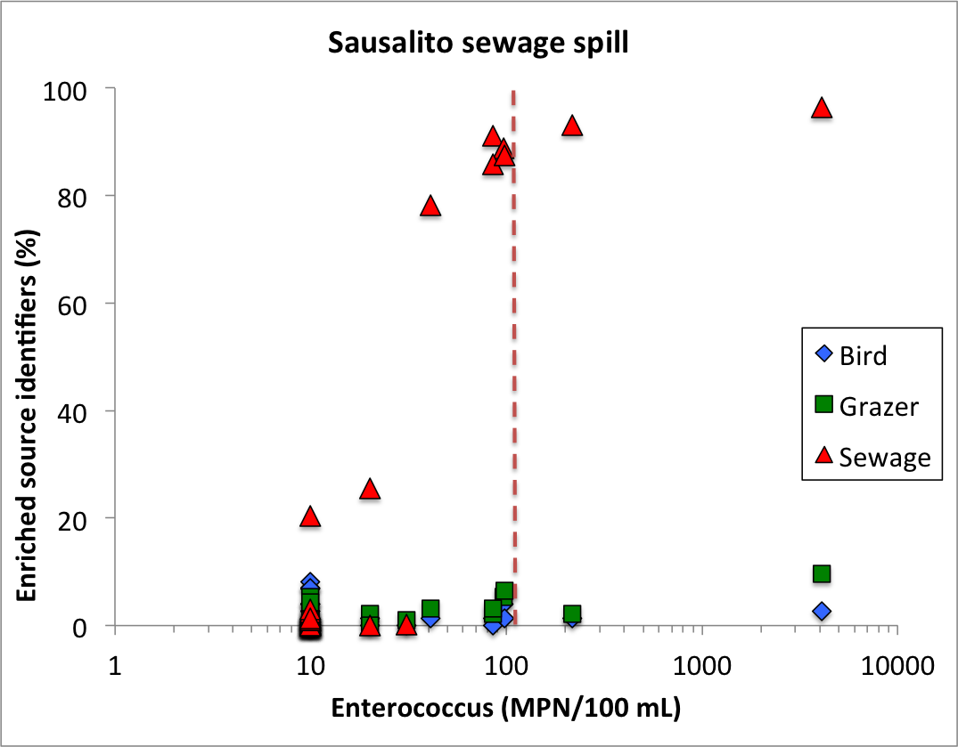

Slide 9
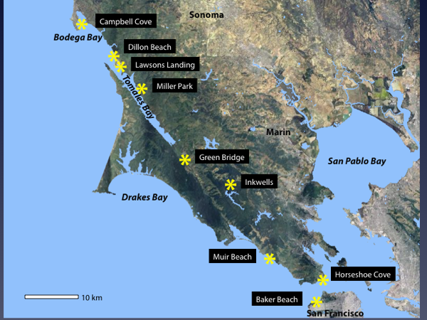
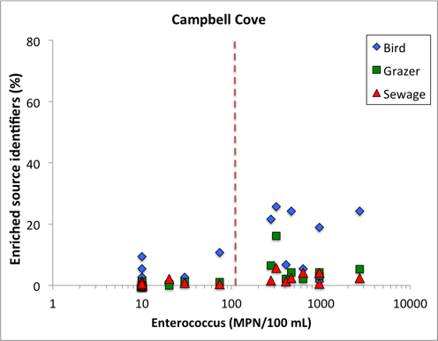
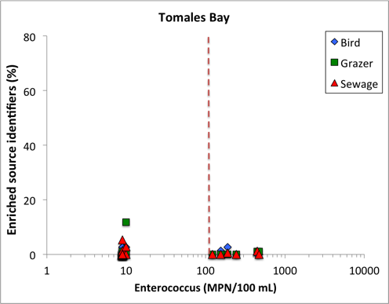
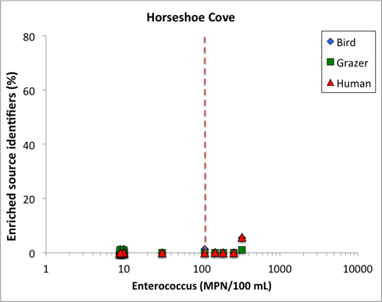
Are human, cattle or wildlife causing water quality problems at popular California beaches?

Slide 10
Blinded study: PhyloChip the only method that identified all fecal sources
 | True positive rate | Number false positives
Chicken | 100 | 0
Cow | 75 | 1
Deer | 100 | 0
Dog | 100 | 0
Goose | 100 | 2
Gull | 83 | 0
Horse | 100 | 0
Human stool | 100 | 0
Pig | 100 | 0
Pigeon | 100 | 0
Septage | 100 | 0
Sewage | 93 | 0

Slide 11
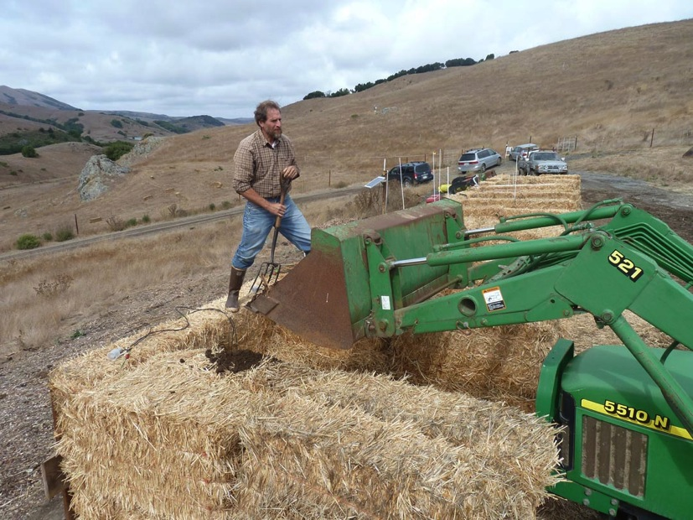
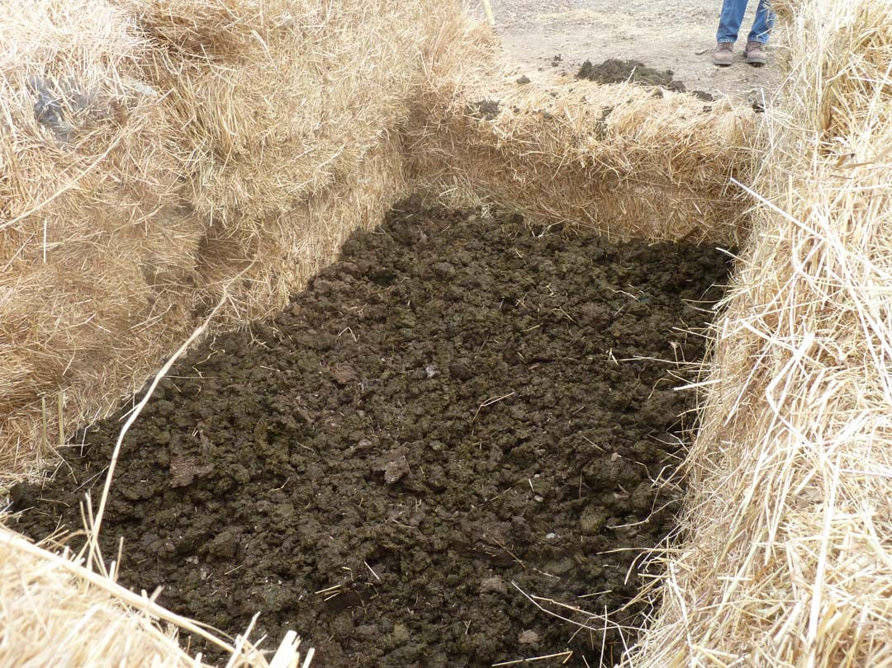

Slide 12
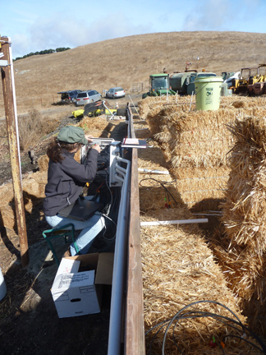

Slide 13
